Slide 1
AdvenShare
Wolfpack 群狼袭击队
Description

Slide 2
Problem & Solution 痛点和解决方案
Problem | Solution
People want to remember their travels but do not have time to keep a hard copy diary Can be difficult to collate photos together in a meaningful way to create lasting memories Information is spread across many sources and can be conflicting due to differences with to | Diary layout and templates Automated Diary Creation You can follow people with similar interests to you so that you can plan and get feedback/ advice based on your preferences

Slide 3
Product Description 产品概述
A more private custom-tailored travel app. Our app has all the information necessary to travel, and adds the ability to automatically generate travel diaries, where people can record all the experiences during the trip and support print services.

Slide 4





Product Description
PLAN
DISCOVER
ABOUT ME
MY DIARY
CHAT

Slide 5
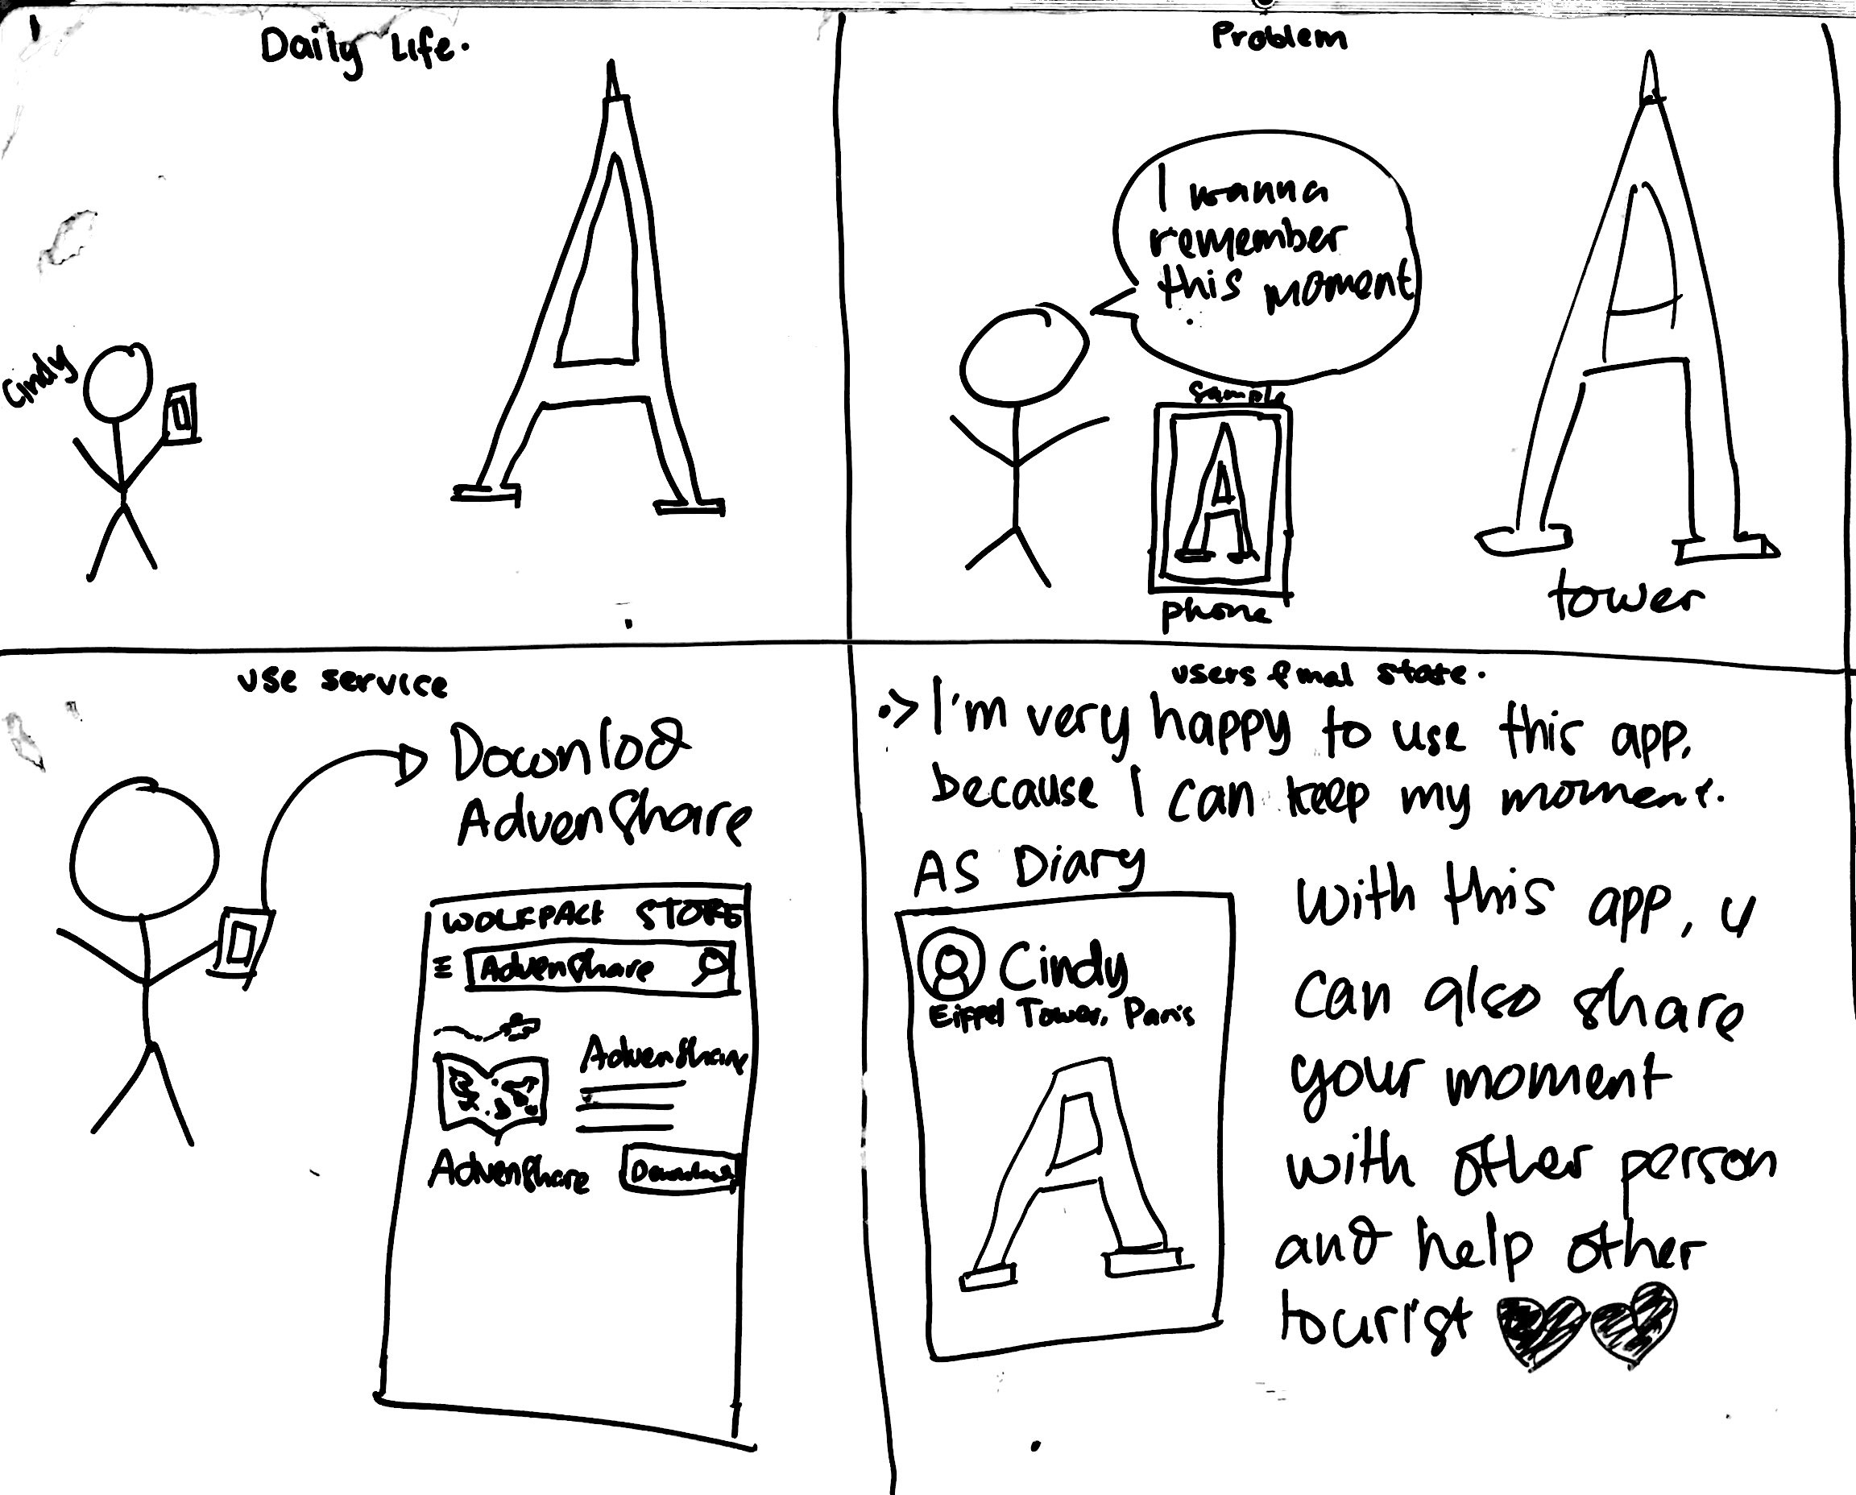
Story Board 1: Create Diaries

Slide 6
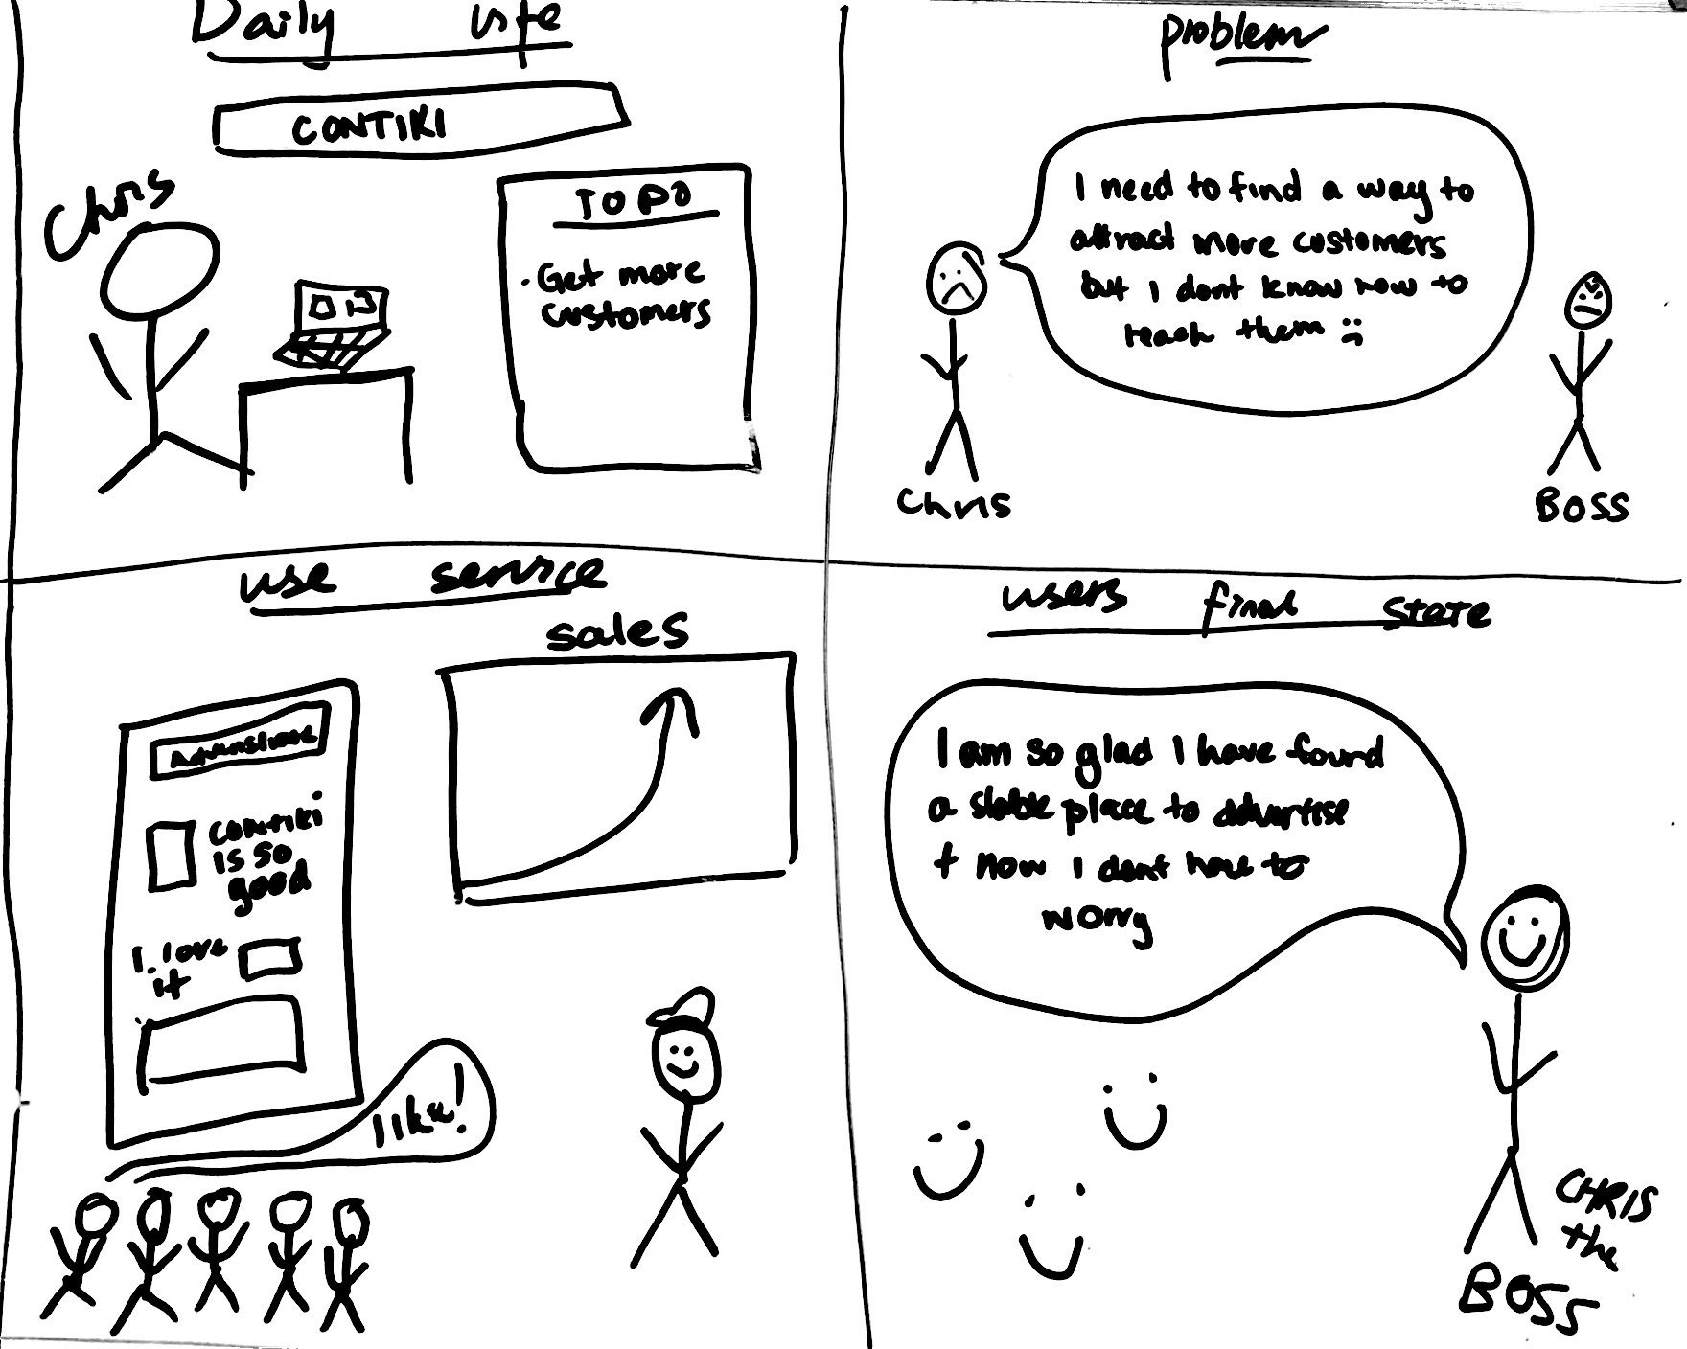
Story Board 2: Tourism Providers

Slide 7
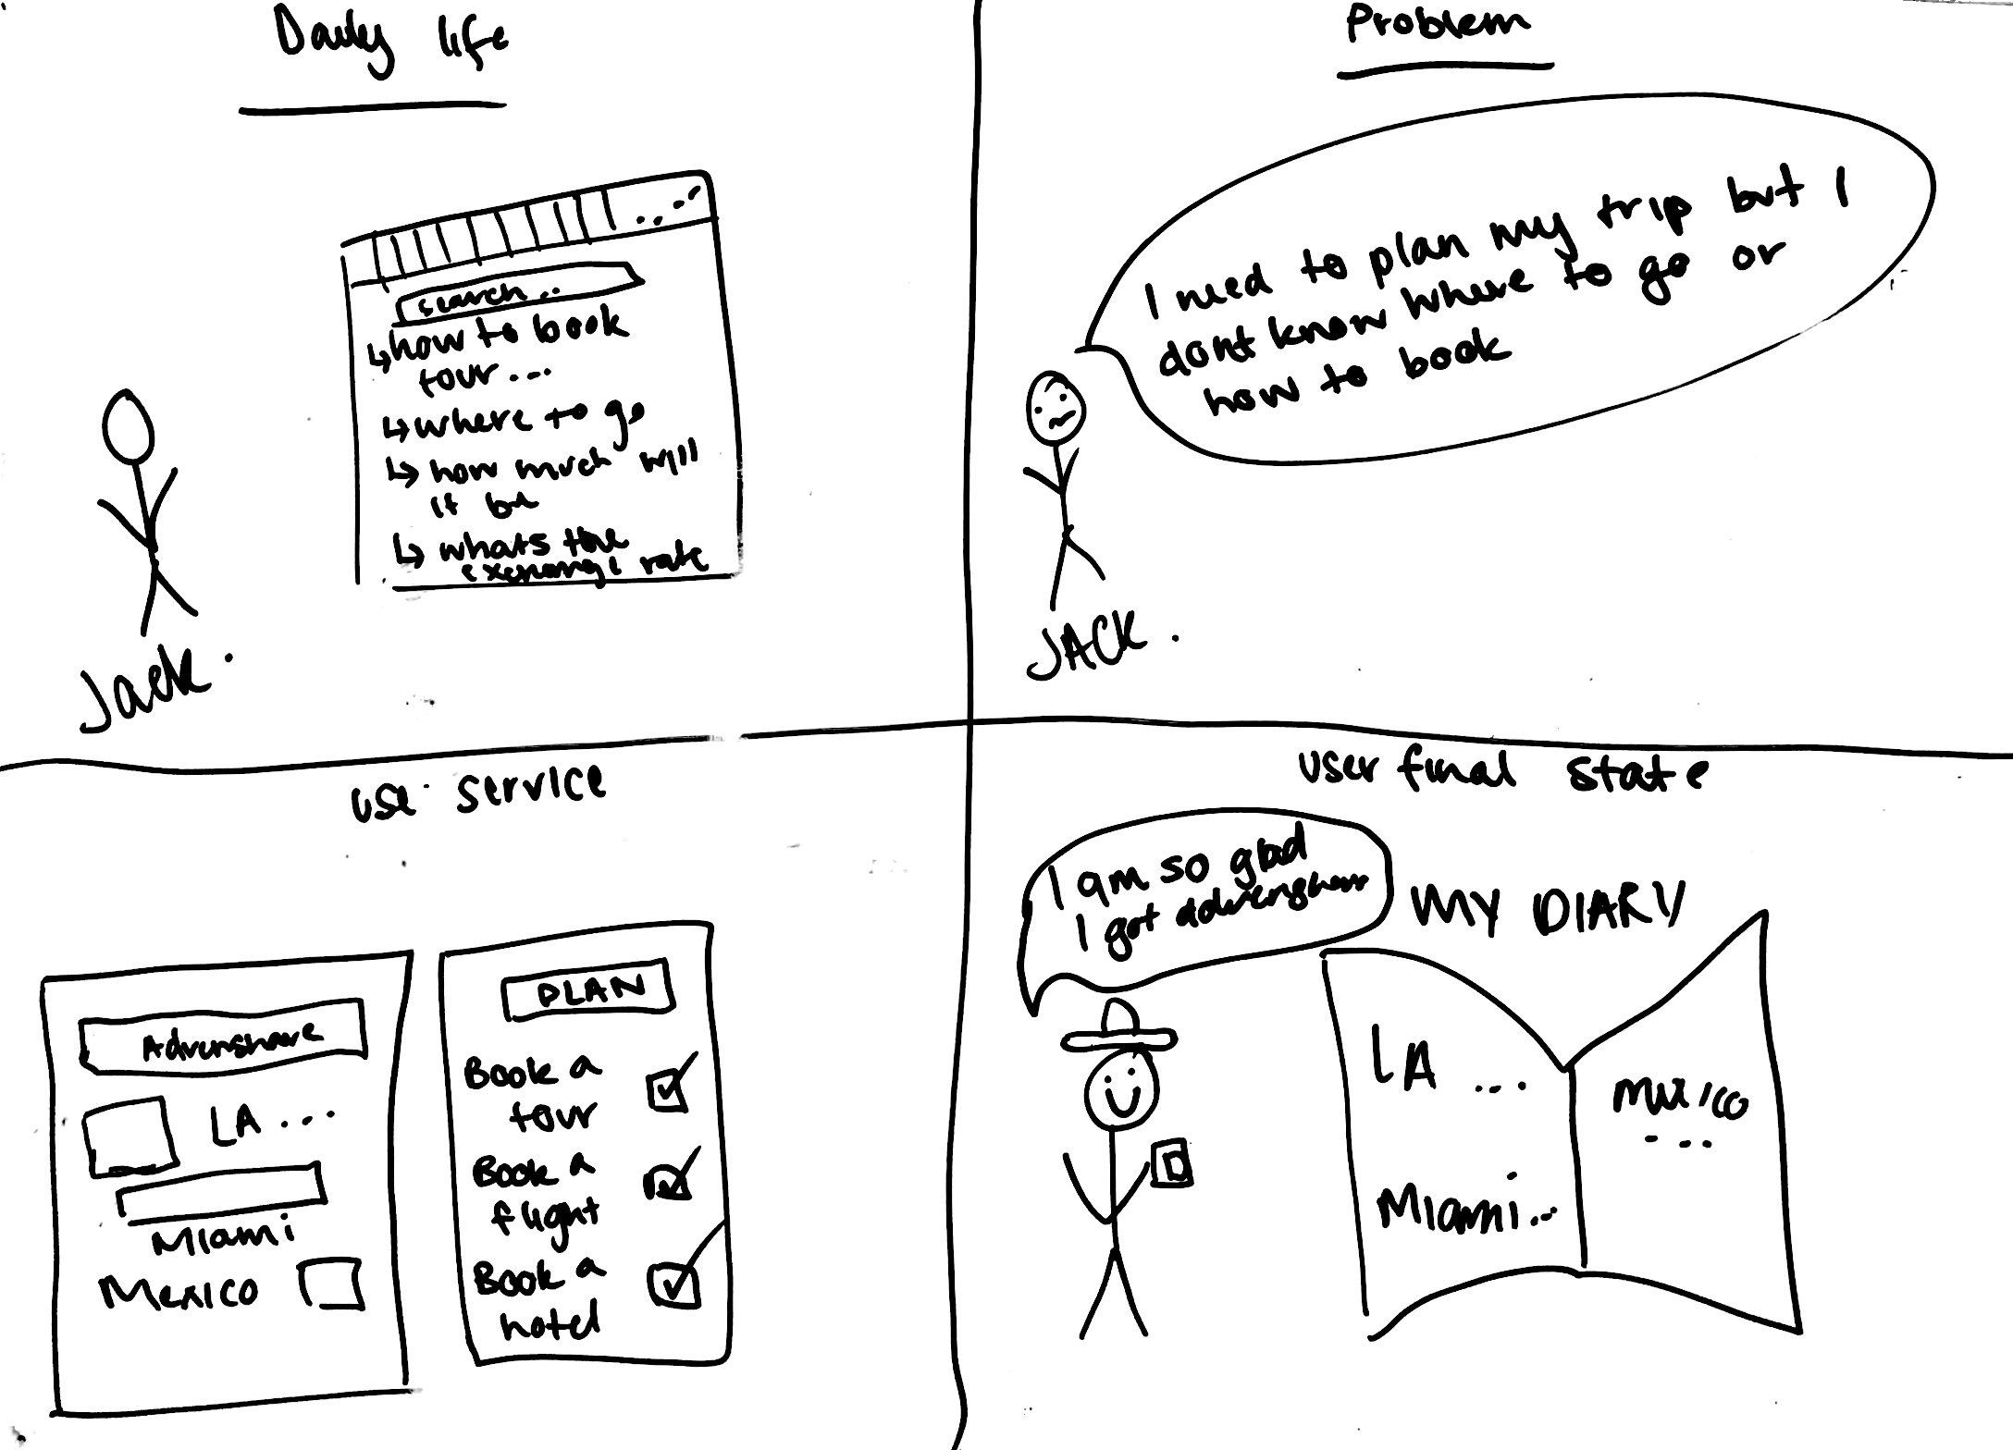
Story Board 3: Plan travel

Slide 8
Business Model 商业模式
Infrastructure |  |  | Offer | Customers
Core Capabilities | Network | Value Configuration | Value Proposition | Target Customers | Delivery Method | Customer Relationships
Basic city info Link Travelers to each other Automate Diary Creation Create online/physical diary Recommend tourism services on preference Advertise tourism | Travel Agency Local Tour Companies Government | Content sharing Story curation Information Moderation Sharing incentives Book Process | Help make memories Help keep memories Target real-time advertising | Traveler Tourism Businesses | Local Guide Supply Mobile App Website Print books Business Website Portal | Free base product Social Networking Community Build large user base Partner for special offers
Cost Structure Large database costs Cloud photo storage Initial Travel Bloggers Employees Marketing |  |  | Finance | Revenue Streams Membership card for travel discounts Bloggers pay to increase click rate Booking fee Create our own tours Companies pay to boost stories Offer Advertisements

Slide 9
Market Size 市场潜力
Global tourism expenditure: $2.3 trillion USD
Targeting young demographic (< 30): 15%
TripAdvisor had 13.4% of internet tourism traffic, leading to $1.48 billion USD revenue in 2016
Hotels.com: 3.9%, Marriot International: 3.7%, Booking.com: 3.6%, AirBnb: 3.5%
6.25% of Contiki web traffic comes from social media
Facebook: 79.42%
Youtube: 15.72%
DailyMotion: 1.70%
Reddit: 1.35%
Instagram: 0.45%
2.75% of TopDeck web traffic comes from social media
Facebook: 48.71%
Youtube: 30.70%
Twitter: 8.41%
LinkedIn: 5.71%
Pinterest: 5.04%

Slide 10
Market Size
1.235 Billion International Tourists Worldwide
65% of all people use social media
USD$30 for the current most popular physical diary option

Slide 11
Industry Characteristics 行业
Oligopoly
Some competitors
Significant barriers
Potential for product differentiation
Imperfect availability of information

Slide 12
Industry Characteristics: Porter’s Five Forces
Threat of New Entrants: Tourism industry is very large so many people want to enter
Bargaining Power of Buyers: High since customers can choose from variety of products for suitable price
Bargaining Power of Suppliers: Tourism providers
Threat of Substitute Products: Many available apps
Threat of Current Competitors: Social media: Facebook, Instagram, Tumblr, travel blogs etc

Slide 13
Competitor Analysis 竞争对手分析
Advantages 我们的优势:
DIY
Innovation
Convenient
Support for no network use
Disadvantages 我们的劣势:
No reputation
Fierce competition
Existing technical conditions are limited

Slide 14
Competitor Analysis 竞争对手分析: Ctrip
Who: popular and famous travel app in China
Where: can be used everywhere
Product & Service: book tickets and accommodation, aggregated itinerary view, customer service, discounts, record
Customers & Partners: travellers, tourism providers, AutoNavi
Prices: free service, commission on bookings
Distribution channel: Online app (iOS, Android)
Advantages: Functional diversity, convenient, discount activities, useful information and advice, reputation

Slide 15
Competitor Analysis 竞争对手分析: traveldiariesapp.com
Who: Online travel diary creator
Where: Online
Product & Service: Manual diary creation (images, text and maps), publish diaries/blogging, printing physical diaries
Customers & Partners: travellers
Prices: Diary creation is free, printing physical copy for fee
Distribution channel: Online, couriers posting
Advantages: Online, convenient, simple UI, free

Slide 16
Marketing Strategy 市场战略
Events
Submit your best travel itinerary to win
Get your diary on top of everyone’s feed
Send you on a trip
Pay for the trip you just went on
Partnerships
Tourism bloggers/Social media travel influencers
Local tourism providers
Tour guide to create detailed diary of trip – share with travelers
Actions
Ability to share diaries to web platform
Allows influencers to publish links to diaries created by us to Facebook/Instagram to showcase potential of AdvenShare
Reading reviews for competitor apps
Push notifications when switching to airplane mode (or location leaves country)

Slide 17
Team Milestones 团队里程碑
Team Milestones 团队里程碑
Phase 1 (pre-accelerator)
Accelerator + investor application process
Initial Business Plan
Market Validation
Prototype + Business plan adjustment
Finish development of initial prototype
Phase 2 (pre-seed funding)
Partnership development
Finalise development for version 1
Launch on the Google Play store
Bug Fixes and customer support
Launch on the iOS store
Phase 3 (last path to revenue)
Begin marketing plan (Facebook)
Travel blogger reviews
Bug fixes and review update
Roll out of full services (advertising, book etc)
Revenue stream

Slide 18
Founder Team 创始人团队
Founder team analysis and organizational structure
Team composition and division
Team advantages
Team building

Slide 19
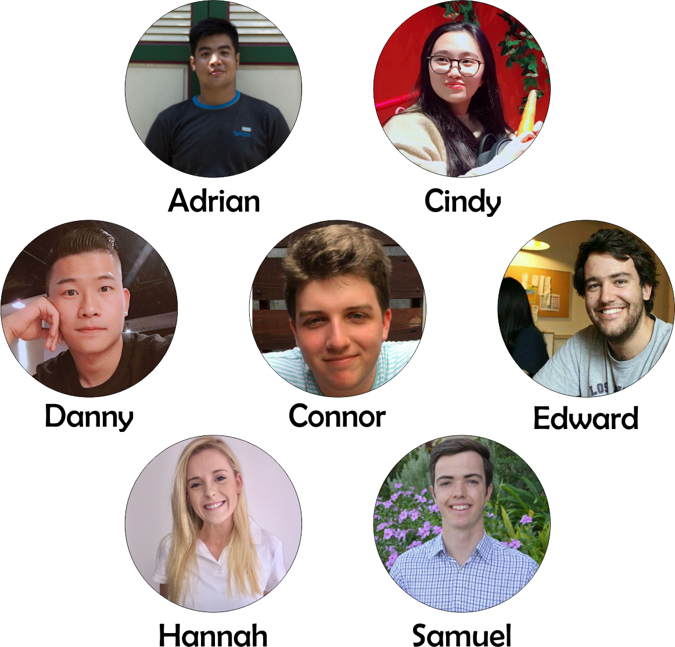
Team-团队

Slide 20

Team - 团队
Connor Cashman
Chiefly responsible for the project schedule and
project plan and how progress compares to the plan.
The programmer is responsible for turning the
need for system capabilities into something a computer
with actually run. Responsible for realising, as closely
as possible, the requirements and designs developed
by the team. This helps ensure that what the
programmer produces is what the stakeholders
actually want.
Manager & Programmer

Slide 21

Team - 团队
Edward Southall
Understands the overall structure of the software
system. Must ensure a modular system and keeps
an eye on the bigger picture.
As with other roles, part of the build-master's job is
to establish practices for others, and part is to
administer the version and configuration system.
System Architect &
Configuration Control

Slide 22

Team - 团队
Zhao Zihao
Ensures that quality goals are being met. Produces a
good iteration and test plan and ensures it is executed
at a high standard. Must establish standard practices
and expectations.
Quality Control

Slide 23

Team - 团队
Wang Si Wei
Creates documentation for the users of the software
system (end users and administration). Documentation
may include user manuals, online help, web based
documents and FAQs and information.
User Documentation

Slide 24

Team - 团队
Hannah Jury
Understanding and communication the system
requirements (which define the functional behaviour
and qualities). Identifies the stakeholders, eliciting
requirements, establishing priorities and documenting
progress.
Requirements Analyst

Slide 25

Team - 团队
Samuel Eadie
Documentation written for developers and maintainers
of a system. Includes formal requirements, design
documents, README files and comments in code.
Also coordinates work of several people to ensure it
is consistent.
Technical Documentation

Slide 26
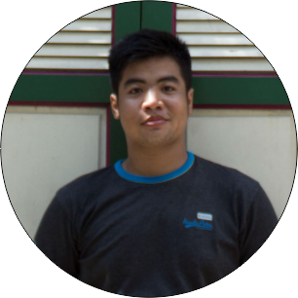
Team - 团队
Adrian Rahardjo
Usability expert who takes usability into consideration.
Responsible for ensuring that usability decisions are
not overlooked.
User Interface

Slide 27
Team - 团队
Work Ratio

Slide 28
Financial Plan 融资计划
Cost Estimation for the first 3 months
Costs | Estimated spending | Additional Information | Item Total
Development | $1600 per month | Cost of living for devs | 4800
Advertising | $0.27 per user reached | Targeted facebook ads | 1890
Travel bloggers | 39.99 per blogger | Offer them a free book of their travel if they use and review our app | 399.9
Partner relationship development |  | Case by case basis | $2,000
FireBase | $25 per month | Firebase cost for <100k users | 75
Google Play Store | $25 | One off publishing fee | 25
Apple App store | 99 |  | 297
 |  | Total Spending | 9486.9

Slide 29
Teamwork/ Management 团队合作与管理
Week 3
Created plan, discover, my diary, me and chat app tabs
Finalised design
Created firebase backend
Moved documentation to Github Wiki
Week 2
Created Feature List
Initial UI Designs
Built basic app with routing
Created initial documentation
Week 1
Formulated team and company
Created initial idea
Week 4
Made a business plan
Made a marketing plan
Analyzed industry

Slide 30
Thank you！ 谢谢大家！

